Slide 1
NYC Parking Tickets: An Exploratory Analysis (Big Data)
Group Name:
Deepak Aneja
Suresh Balla
Merin Jose
Fayiz Mayam Veettil
15 Jul 2018

Slide 2
Table of Contents
About the data
Reading data into S3 (screenshot of the S3 bucket of all four members)
Exploratory Data Analysis
Examine Data
Aggregation Tasks

Slide 3
About the data
Data on Parking ticket issued in NYC, collected by NYC Department of Finance
Data Source: Kaggle
https://www.kaggle.com/new-york-city/nyc-parking-tickets
2015, 2016 and 2017 data sets are used for analysis
Total 6.6 GB of data across all three years
The files are roughly organized by fiscal year (July 1 - June 30) of NYC government, hence all the analysis done based on fiscal year and each metric compared across the 3 years.
External data from nyc.gov for Violation Code Fines are used for revenue analysis

Slide 4
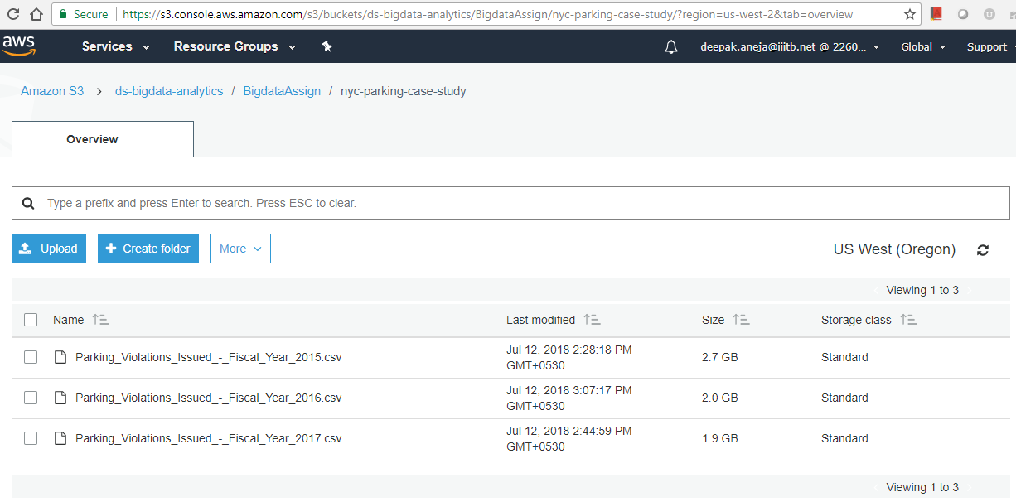
(Bucket Path : s3://fayiz-bigdata-assignment/nyc-parking-case-stud/)
S3 Bucket: Deepak Aneja (Bucket Path: s3://ds-bigdata-analytics/BigdataAssign/nyc-parking-case-study/)

Slide 5
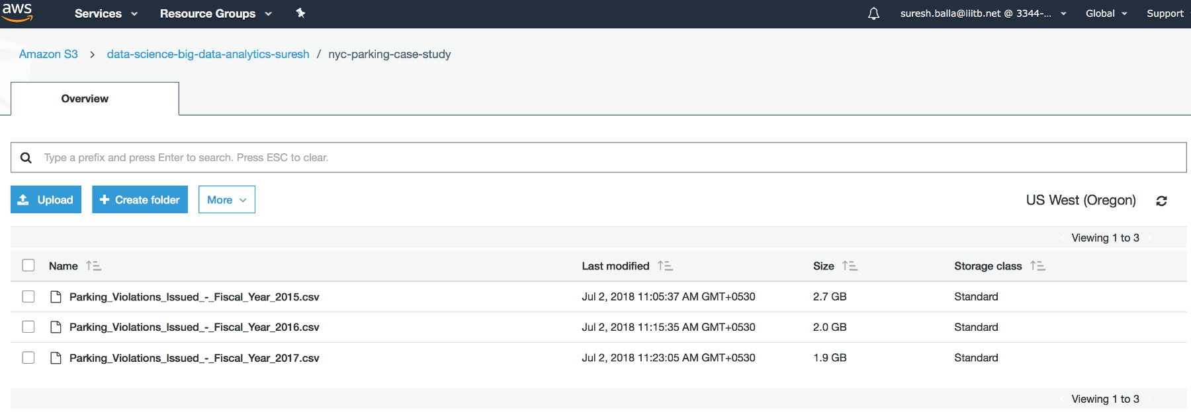
(Bucket Path : s3://fayiz-bigdata-assignment/nyc-parking-case-stud/)
S3 Bucket: Suresh Balla (Bucket Path: s3://data-science-big-data-analytics-suresh/nyc-parking-case-study/)

Slide 6
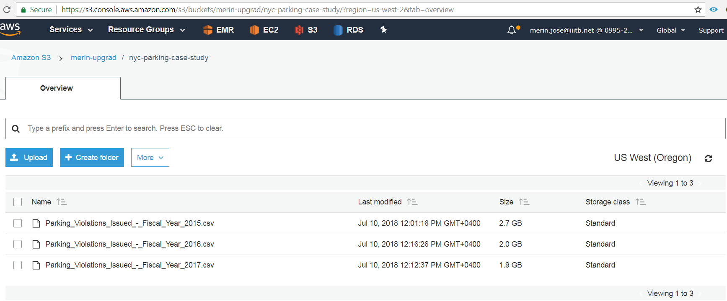
(Bucket Path : s3://fayiz-bigdata-assignment/nyc-parking-case-stud/)
S3 Bucket: Merin Jose (Bucket Path: s3://merin-upgrad/nyc-parking-case-study/)

Slide 7
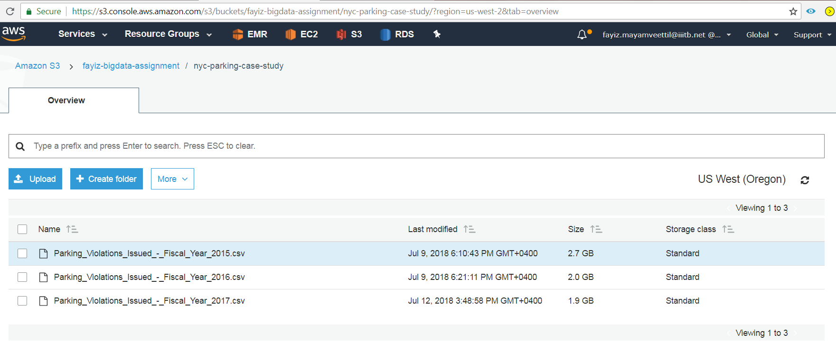
(Bucket Path : s3://fayiz-bigdata-assignment/nyc-parking-case-stud/)
S3 Bucket: Fayiz Mayam Veettil (Bucket Path: s3://fayiz-bigdata-assignment/nyc-parking-case-study/)

Slide 8
Exploratory Data Analysis
Check for possible data inconsistencies
Check for duplicate records on Summons Number
Check for NA values in the columns used for analysis
Status of data cleaning
2017 dataset lacks 8 columns that are included in the other 2 datasets
Each files contains data from current year July 1st to June 30th next year
~10 M records per year
857,977 number of records found duplicated and cleaned in 2015 data file

Slide 9
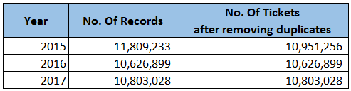
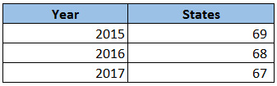
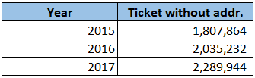
Examine the data
1. Find total number of tickets for each year.
2. Find out how many unique states the cars which got parking tickets came from.
3. Some parking tickets don’t have addresses on them, which is cause for concern. Find out how many such tickets there are.

Slide 10
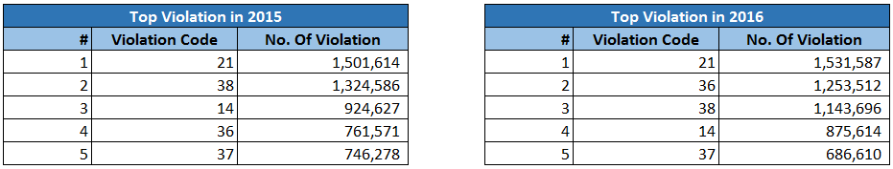
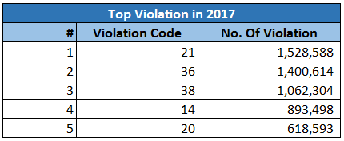
Aggregation Tasks
1. How often does each violation code occur? (frequency of violation codes - find the top 5)

Slide 11
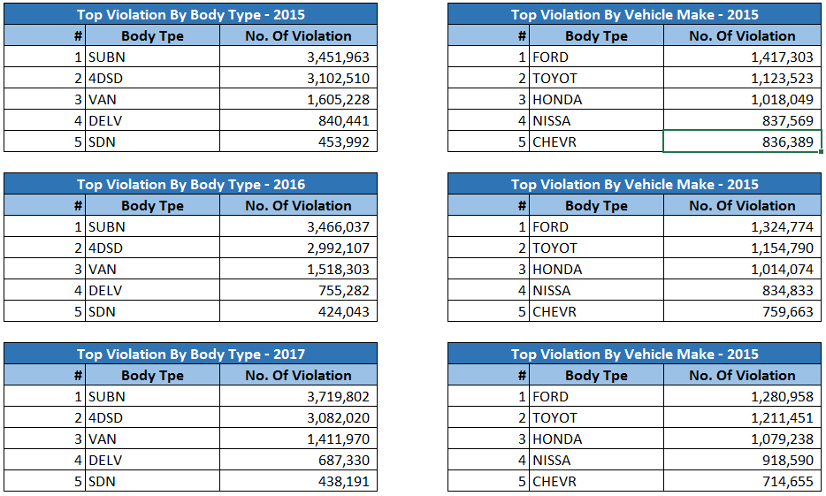
Aggregation Tasks
2. How often does each vehicle body type get a parking ticket? How about the vehicle make? (find the top 5 for both)

Slide 12
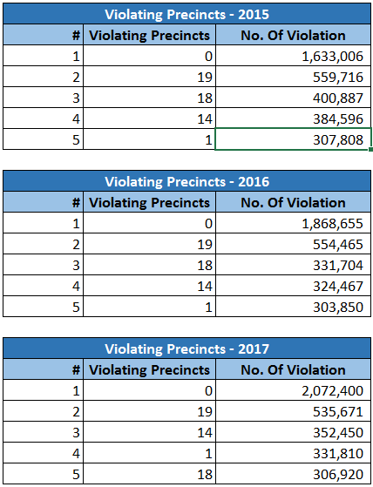
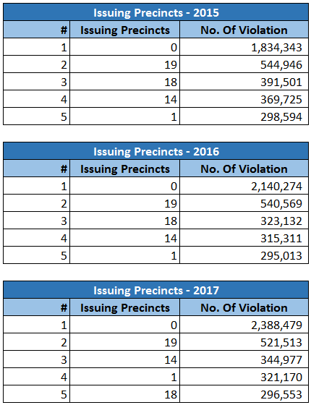
Aggregation Tasks
3. A precinct is a police station that has a certain zone of the city under its command. Find the (5 highest) frequencies of:
Violating Precincts (this is the precinct of the zone where the violation occurred)
Issuing Precincts (this is the precinct that issued the ticket)

Slide 13
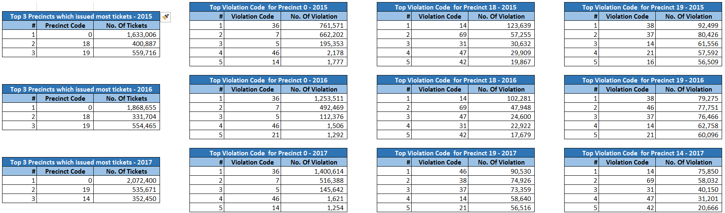
Aggregation Tasks
Find the violation code frequency across 3 precincts which have issued the most number of tickets - do these precinct zones have an exceptionally high frequency of certain violation codes? Are these codes common across precincts?
- Assumption: Precincts Code 0 is considered as one of the Precincts
- Precincts 0, 19, 18 and 14 are the top Precincts across all 3 years
- No consistency in violation codes however code 14, 46 are most common in all year/precincts

Slide 14
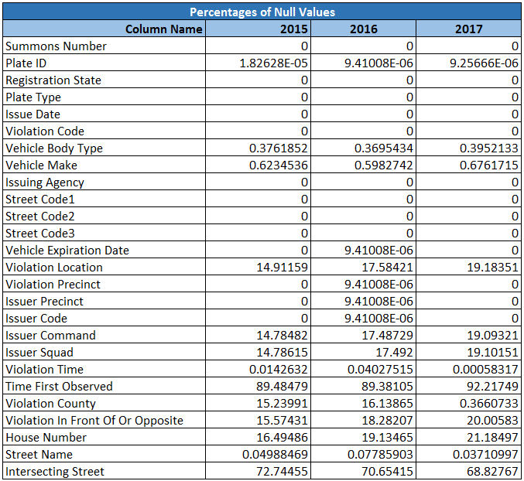
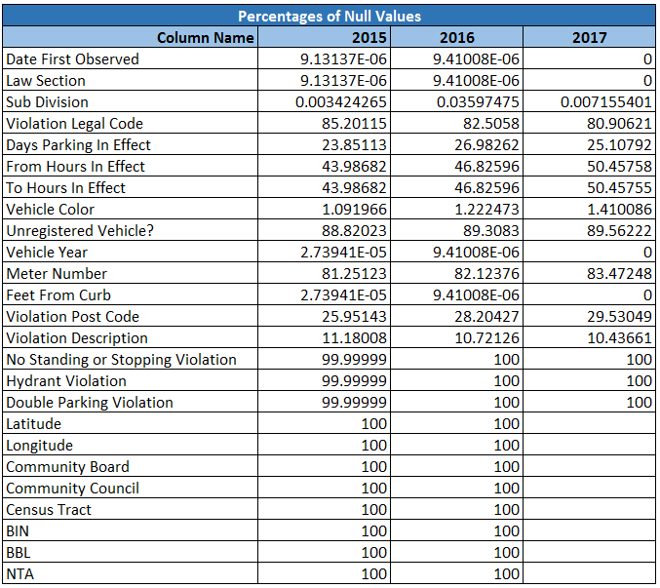
Aggregation Tasks
You’d want to find out the properties of parking violations across different times of the day:
The Violation Time field is specified in a strange format. Find a way to make this into a time attribute that you can use to divide into groups.
Find a way to deal with missing values, if any.

Slide 15
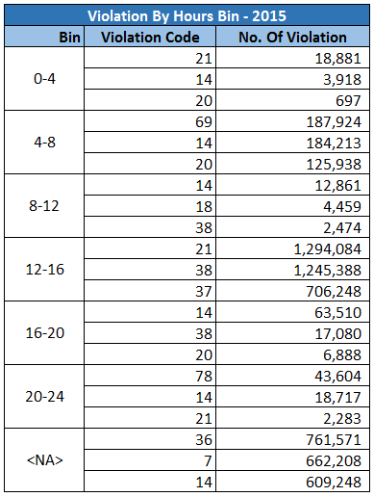
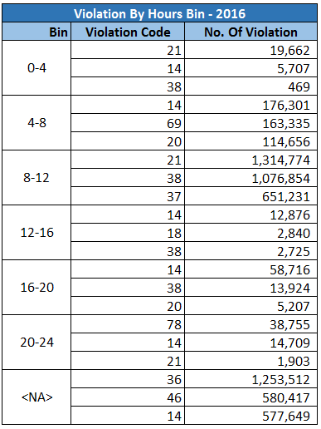
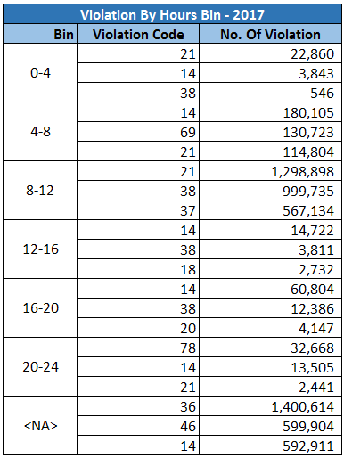
Aggregation Tasks
You’d want to find out the properties of parking violations across different times of the day:
c) Divide 24 hours into 6 equal discrete bins of time. The intervals you choose are at your discretion. For each of these groups, find the 3 most commonly occurring violations
* NA's in the result sets are kept separately as it's not logical to add them in any of the time bin, unless otherwise specified

Slide 16
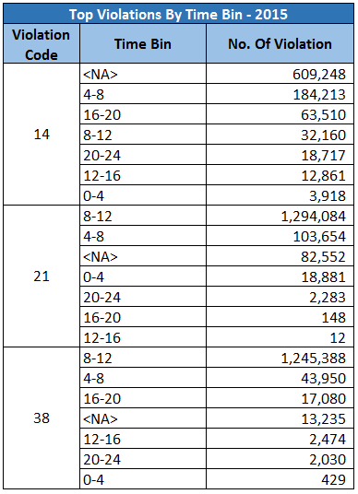
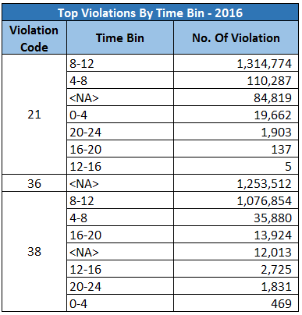
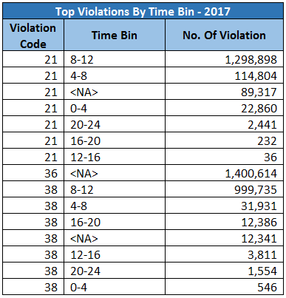
Aggregation Tasks
You’d want to find out the properties of parking violations across different times of the day:
d) Now, try another direction. For the 3 most commonly occurring violation codes, find the most common times of day (in terms of the bins from the previous part)
* NA's in the result sets are kept separately as it's not logical to add them in any of the time bin, unless otherwise specified

Slide 17
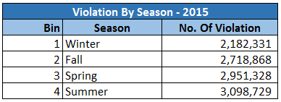
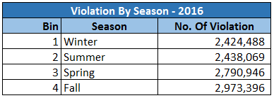
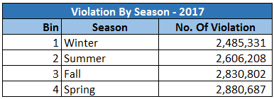
Aggregation Tasks
6. Let’s try and find some seasonality in this data
First, divide the year into some number of seasons, and find frequencies of tickets for each season.

Slide 18
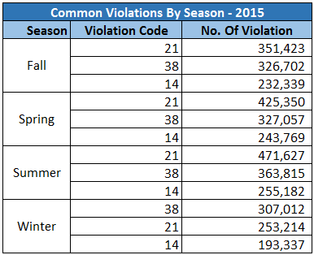
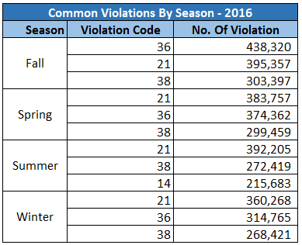
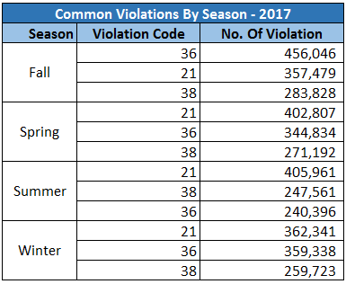
Aggregation Tasks
6. Let’s try and find some seasonality in this data
b) Then, find the 3 most common violations for each of these season

Slide 19
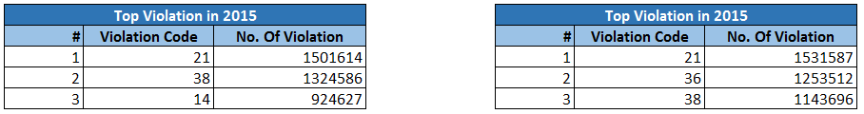
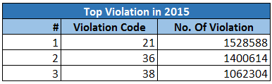
Aggregation Tasks
7. The fines collected from all the parking violation constitute a revenue source for the NYC police department. Let’s take an example of estimating that for the 3 most commonly occurring codes.
Find total occurrences of the 3 most common violation code

Slide 20
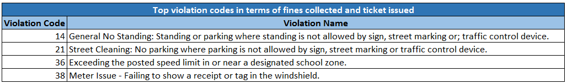
Aggregation Tasks
7. The fines collected from all the parking violation constitute a revenue source for the NYC police department. Let’s take an example of estimating that for the 3 most commonly occurring codes.
b) Then, search the internet for NYC parking violation code fines. You will find a website (on the nyc.gov URL) that lists these fines. They’re divided into two categories, one for the highest-density locations of the city, the other for the rest of the city. For simplicity, take an average of the two.

Slide 21
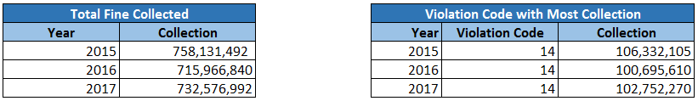
Aggregation Tasks
The fines collected from all the parking violation constitute a revenue source for the NYC police department. Let’s take an example of estimating that for the 3 most commonly occurring codes.
c) Using this information, find the total amount collected for all of the fines. State the code which has the highest total collection.
What can you intuitively infer from these findings?
Top Violation by count in 3 years is with code 21 which is "Street Cleaning: No parking where parking is not allowed by sign, street marking or traffic control device. but max revenue is with code 14 which has higher fine for issue "Street Cleaning: No parking where parking is not allowed by sign, street marking or traffic control device."

Slide 22
Thanks
Merin Jose
Suresh Balla
Deepak Aneja
Fayiz Mayam Veettil

